Slide 1
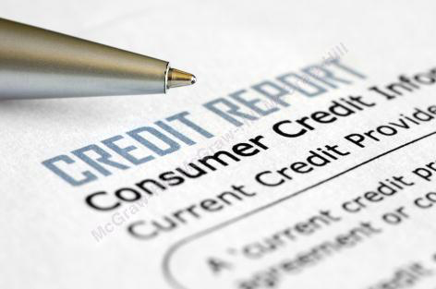
Consumer Protection
Chapter 14
©2020 McGraw-Hill Education. All rights reserved. Authorized only for instructor use in the classroom. No reproduction or further distribution permitted without the prior written consent of McGraw-Hill Education.

Slide 2
Rights of Consumers
The right to be informed.
The right to safety.
The right to choose.
The right to be heard.
The right to privacy.
Notes:
1. The right to be informed.
Protection against fraudulent, deceitful, or grossly misleading information, advertising, and labeling, and to be given the facts to make an informed purchasing decision.
2. The right to safety.
Protection against the marketing of goods that are hazardous to health or life.
3. The right to choose.
Assurance of access to a variety of products and services at competitive prices.
4. The right to be heard.
Assurance that consumer interests will receive full and sympathetic consideration in government policy and the courts.
5. The right to privacy.
Assurance that information disclosed in a commercial transaction or when using social media or searching online is not shared with others.

Slide 3
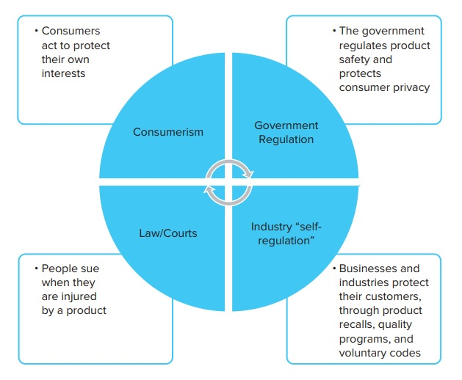
Four Methods of Protecting Consumers
Copyright © McGraw-Hill Education. Permission required for reproduction or display.
Figure 14.1
Access the text alternative for these images.

Slide 4
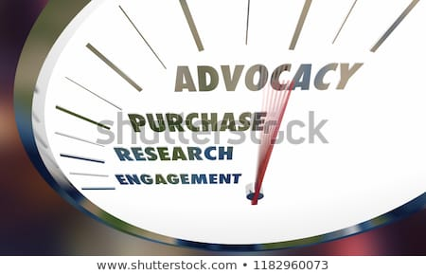
Consider
Self-Advocacy for Consumer Interests
How Government Protects Consumers
Goals of Consumer Laws
Deceptive Advertising
Notes:
Self-Advocacy for Consumer Interests
As long as business has existed:
Consumers have tried to protect their interests when they go to the marketplace to buy goods and services.
Consumerism/consumer movement
Collective efforts by consumers in many countries to safeguard their own rights in many nations.
Examples: U.S. advocacy organizations:
Consumer Federation of America.
National Consumers League.
Public Interest Research Group.
American Association for Retired People.
How Government Protects Consumers
The role of government protecting consumers is extensive in the United States as well as many other nations.
Consumer protection laws are designed to safeguard the five rights of consumers.
Goals of Consumer Laws
1. To provide consumers with better information when making purchases.
2. To protect consumers against possible hazards.
3. To promote competitive pricing.
4. To promote consumer choice.
5. To protect privacy.
Deceptive Advertising
Deceptive advertising: refers to manufacturers making false or misleading claims about their own product or a competitor’s product, withholding relevant information, or creating unreasonable expectations.
Illegal in most countries.
The U.S. Federal Trade Commission enforces the laws prohibiting deceptive advertising.
The U.S. Justice Department enforces related laws prohibiting false claims.

Slide 5
Major Consumer Protection Agencies1
Copyright © McGraw-Hill Education. Permission required for reproduction or display.
From Figure 14.3
Agency | Major Responsibilities
Federal Trade Commission | Competitive pricing. Deceptive trade practices. Packaging and labeling. Consumer credit disclosure and reporting. Online privacy.
Food and Drug Administration | Safety, effectiveness, and labeling of drugs, foods, food additives, cosmetics, and medical devices. Standards for radiation exposure. Toxic chemicals research.
Consumer Product Safety Commission | Safety standards for consumer products. Flammable fabrics, hazardous substances, poison prevention packaging.

Slide 6
Major Consumer Protection Agencies2
Copyright © McGraw-Hill Education. Permission required for reproduction or display.
From Figure 14.3
Agency | Major Responsibilities
National Highway Traffic Safety Administration (Transportation Department) | Motor vehicle safety standards. Automobile fuel economy standards. National uniform speed limit. Consumer safeguards for altered odometers.
Department of Justice | Fair competition. Consumer civil rights.
National Transportation Safety Board | Airline safety.
Consumer Financial Protection Bureau | Fairness and transparency in consumer financial products and services.
Department of Agriculture | Safety of meat and poultry.

Slide 7

Consumer Privacy in the Digital Age1
Rapidly evolving information technologies in the early 21st century led to the issue of consumer privacy:
  New technologies enabled businesses to collect and use vast amounts of personal data about their customers.
  The dangers:
  Information might rarely be used fraudulently.
  Unwarranted violation into personal privacy.

Slide 8


Consumer Privacy in the Digital Age2
Behavioral advertising
Dilemma: how to protect consumer privacy while fostering Internet commerce?
Notes:
Behavioral advertising: advertising that is targeted to particular customers, based on their observed online behavior; intended to be tailored to a user’s interests and preferences.
Benefits:
The buyer is more likely to receive messages that are relevant.
The seller is more likely to reach prospective customers.
Risks:
The consumer may be denied opportunities, such as credit, based on their online profiles.
Information collected by behavioral advertisers may not be kept private and secure.
Dilemma: how to protect consumer privacy while fostering Internet commerce?
Proposed solutions:
Consumer self-help:
Internet users should use technologies that enable them to protect their own privacy.
Industry self-regulation:
Internet-related businesses advocate being allowed to regulate themselves.
Privacy legislation:
Favor new government regulations protecting consumer privacy online.

Slide 9
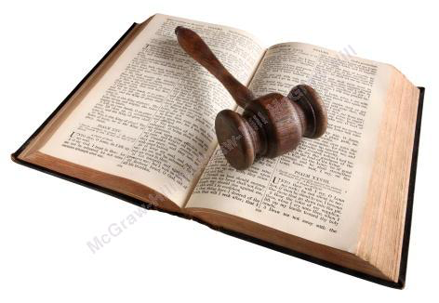
Using the Courts and Product Liability
Product Liability: the legal responsibility of
a firm for injuries caused by something it
made or sold.
Strict liability – manufacturers are responsible for injuries resulting from use of their products, whether or not they were negligent or breached a warranty.
Product liability systems of other nations differ significantly from that of the United States.
Notes:
Product Liability: the legal responsibility of a firm for injuries caused by something it made or sold.
In U.S. and some other countries, consumers have right to sue and collect damages if harmed by unsafe products.
Consumer advocates and trial attorneys have supported these legal protections.
By contrast, some in the business community have argued courts and juries have unfairly favored plaintiffs and have called for reform.
Strict liability – manufacturers are responsible for injuries resulting from use of their products, whether or not they were negligent or breached a warranty.
May be held liable, whether or not they knowingly did anything wrong.
→ Example: Johnson & Johnson.
Huge settlements, like the Johnson & Johnson case, are the exception. Statistics show plaintiffs win about 34% of the cases filed for an average $201,000 award.
Product liability systems of other nations differ significantly from that of the United States.
In Europe, judges (not juries) hear cases:
Punitive damages are not allowed.
Victims’ health expenses are not an issue as they are covered by national health insurance.
Historically, product liability cases have been exceedingly rare in China.
But, that began to change in 2009, in the wake of China’s tainted-milk scandal.

Slide 10
Product Liability Reform and Alternative Dispute Resolution
In 2005, Congress passed the Class Action Fairness Act, the first significant product liability reform in many years.
The two key elements of this legislation were:
Attorneys in some kinds of cases were paid based on:
How much plaintiffs actually received
How much time the attorney spent on the case
Most class-action lawsuits moved from state to federal courts

Slide 11


Alternative Dispute Resolution (ADR)1
One approach to settling disagreements between companies and consumers, other than going to court.
Can take the form of:
  Mediation
  Arbitration
Notes:
One approach to settling disagreements between companies and consumers, other than going to court.
Can take the form of:
Mediation: a voluntary process to settle disputes using a third party neutral.
Arbitration: the use of an impartial individual to hear and decide a case outside of the judicial system.
Argument in favor of ADR:
It is a faster and less expensive way to resolve company-consumer disputes and does not tie up the judicial system with minor issues.
A controversial aspect of consumer ADR is the use of mandatory arbitration clauses that limit consumers’ right to sue.

Slide 12
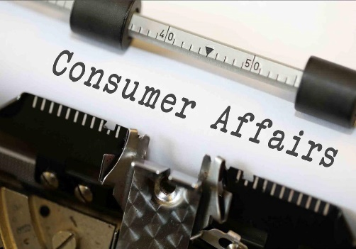


Positive Business Responses to Consumerism1
Managing for quality:
Consumer affairs departments
Voluntary industry codes of conduct
Product recalls
Notes:
Managing for quality:
Quality management: all the measures an organization takes to assure quality.
Taking steps at all stages of the production process to ensure consistently high quality has many benefits.
Building products right reduces the risk of liability lawsuits and builds brand loyalty.
Managing for product and service quality is an attempt by business to address its customers’ needs.
Complex issue: When a safe and high quality product is used in illegal or dangerous ways.
Voluntary industry codes of conduct:
Businesses in some industries have banned together to agree on voluntary codes of conduct, spelling out how they will treat their customers.
Example: The Western Growers Association adopted voluntary guidelines for growers and handlers of leafy green vegetables.
Consumer affairs departments:
Manage a complex network of contacts with customers.
Handle consumer inquiries and complaints about a company’s products and services.
Through:
Consumer hot lines.
Interactive web sites.
Sophisticated software that pulls customer feedback from multiple channels:
→ Examples: Surveys, social media, and unsolicited feedback.
Product recalls:
Occurs when a company, either voluntarily or under an agreement with a government agency, takes back all items found to be dangerously defective.
Problem: the public may not be aware of them, so dangerous products continue to be used.
The four major government agencies responsible for most mandatory recalls:
Food and Drug Administration.
National Highway Traffic Safety Administration.
Environmental Protection Agency (which can recall polluting motor vehicles).
Consumer Product Safety Commission.

Slide 13

Consumerism’s Achievements
Consumers today benefit:
  Better information about the goods and services they purchase.
  More aware of their rights when something goes wrong.
  Better protected against inflated advertising claims, hazardous or ineffective products, and unfair pricing.

Slide 14
End of Main Content
Notes:
Closing slide.

